Slide 1


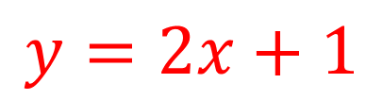
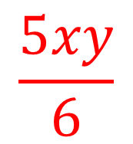
My Algebra
Interactive Notebook
$$\frac{5xy}{6}$$
$$3ab$$
$$2x+3y$$
$$y=2x+1$$
Name
Class
Term 3 Semester 2

Slide 2
Contents
Page
Date
Description
2
3

Slide 3
Tasks
24
7
30
Essential Question
Questions
Notes
Summary
6
7

Slide 4
24
7
30
Date
Factorising
EQ – Describe the process of factorising an expression?
7

Slide 5
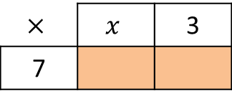
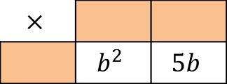
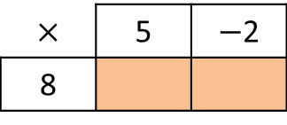
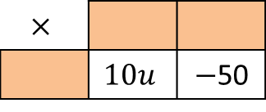

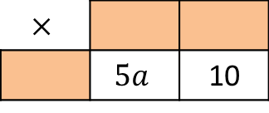
Task - Fill in the multiplication grids
1)
$$×$$ | 5 | $−$2
8
4)
$$×$$
 | $$6p$$ | 18
2)
$$×$$ | $$x$$ | 3
7
5)
$$×$$
 | $$10u$$ | $−$50
3)
$$×$$
 | $$5a$$ | 10
6)
$$×$$
 | $$b^{2}$$ | $$5b$$

Slide 6
Task - Fill in the multiplication grids
1)
$$×$$ | 5 | $−$2
8
4)
$$×$$
 | $$6p$$ | 18
2)
$$×$$ | $$x$$ | 3
7
5)
$$×$$
 | $$10u$$ | $−$50
3)
$$×$$
 | $$5a$$ | 10
6)
$$×$$
 | $$b^{2}$$ | $$5b$$
Discuss with a partner – Do you agree/disagree?

Slide 7
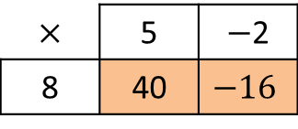
Fill in the multiplication grids
1)
$$×$$ | 5 | $−$2
8 | 40 | $$−16$$
4)
$$×$$
 | $$6p$$ | 18
2)
$$×$$ | $$x$$ | 3
7
5)
$$×$$
 | $$10u$$ | $−$50
3)
$$×$$
 | $$5a$$ | 10
6)
$$×$$
 | $$b^{2}$$ | $$5b$$

Slide 8
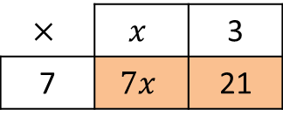
Fill in the multiplication grids
1)
$$×$$ | 5 | $−$2
8 | 40 | $$−16$$
4)
$$×$$
 | $$6p$$ | 18
2)
$$×$$ | $$x$$ | 3
7 | $$7x$$ | 21
5)
$$×$$
 | $$10u$$ | $−$50
3)
$$×$$
 | $$5a$$ | 10
6)
$$×$$
 | $$b^{2}$$ | $$5b$$

Slide 9
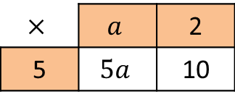
Fill in the multiplication grids
1)
$$×$$ | 5 | $−$2
8 | 40 | $$−16$$
4)
$$×$$
 | $$6p$$ | 18
2)
$$×$$ | $$x$$ | 3
7 | $$7x$$ | 21
5)
$$×$$
 | $$10u$$ | $−$50
3)
$$×$$ | $$a$$ | 2
5 | $$5a$$ | 10
6)
$$×$$
 | $$b^{2}$$ | $$5b$$

Slide 10
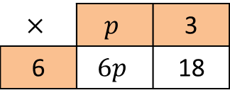
Fill in the multiplication grids
1)
1)
$$×$$ | 5 | $−$2
8 | 40 | $$−16$$
4)
$$×$$ | $$p$$ | 3
6 | $$6p$$ | 18
2)
$$×$$ | $$x$$ | 3
7 | $$7x$$ | 21
5)
$$×$$
 | $$10u$$ | $−$50
3)
$$×$$ | $$a$$ | 2
5 | $$5a$$ | 10
6)
$$×$$
 | $$b^{2}$$ | $$5b$$

Slide 11
Fill in the multiplication grids
1)
1)
4)
More than one answer
6 is the HCF
$$×$$ | 5 | $−$2
8 | 40 | $$−16$$
$$×$$ | $$p$$ | 3
6 | $$6p$$ | 18
2)
$$×$$ | $$x$$ | 3
7 | $$7x$$ | 21
5)
$$×$$
 | $$10u$$ | $−$50
3)
$$×$$ | $$a$$ | 2
5 | $$5a$$ | 10
6)
$$×$$
 | $$b^{2}$$ | $$5b$$

Slide 12
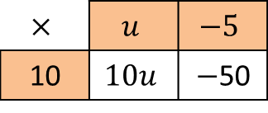
Fill in the multiplication grids
1)
1)
4)
More than one answer
6 is the HCF
$$×$$ | 5 | $−$2
8 | 40 | $$−16$$
$$×$$ | $$p$$ | 3
6 | $$6p$$ | 18
2)
$$×$$ | $$x$$ | 3
7 | $$7x$$ | 21
5)
$$×$$ | $$u$$ | $$−5$$
10 | $$10u$$ | $−$50
3)
$$×$$ | $$a$$ | 2
5 | $$5a$$ | 10
6)
$$×$$
 | $$b^{2}$$ | $$5b$$

Slide 13
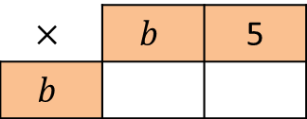
Fill in the multiplication grids
1)
1)
4)
More than one answer
6 is the HCF
$$×$$ | 5 | $−$2
8 | 40 | $$−16$$
$$×$$ | $$p$$ | 3
6 | $$6p$$ | 18
2)
$$×$$ | $$x$$ | 3
7 | $$7x$$ | 21
5)
$$×$$ | $$u$$ | $$−5$$
10 | $$10u$$ | $−$50
More than one answer
10 is the HCF
3)
$$×$$ | $$a$$ | 2
5 | $$5a$$ | 10
6)
$$×$$ | $$b$$ | 5
$$b$$

Slide 14

Fill in the multiplication grids
1)
1)
4)
More than one answer
6 is the HCF
$$×$$ | 5 | $−$2
8 | 40 | $$−16$$
$$×$$ | $$p$$ | 3
6 | $$6p$$ | 18
2)
$$×$$ | $$x$$ | 3
7 | $$7x$$ | 21
5)
$$×$$ | $$u$$ | $$−5$$
10 | $$10u$$ | $−$50
More than one answer
10 is the HCF
3)
$$×$$ | $$a$$ | 2
5 | $$5a$$ | 10
6)
$$×$$ | $$b$$ | 5
$$b$$ | $$b^{2}$$ | $$5b$$

Slide 15
24
7
30
Date
Factorising
EQ – Describe the process of factorising an expression?
Factorising is the opposite of expanding (Put in brackets)
It is used to simplify expressions and solve problems
7

Slide 16
24
7
30
Date
Factorising
EQ – Describe the process of factorising an expression?
Factorising is the opposite of expanding (Put in brackets)
It is used to simplify expressions and solve problems
To factorise –
7

Slide 17

24
7
30
Date
Factorising
EQ – Describe the process of factorising an expression?
Factorising is the opposite of expanding (Put in brackets)
It is used to simplify expressions and solve problems
To factorise –
Example – Factorise $8x+20$
7

Slide 18
24
7
30
Date
Factorising
EQ – Describe the process of factorising an expression?
Factorising is the opposite of expanding (Put in brackets)
It is used to simplify expressions and solve problems
To factorise –
Find the HCF of all the terms
Example – Factorise $8x+20$
7

Slide 19

24
7
30
Date
Factorising
EQ – Describe the process of factorising an expression?
Factorising is the opposite of expanding (Put in brackets)
It is used to simplify expressions and solve problems
To factorise –
Find the HCF of all the terms
Example – Factorise $8x+20$
$$The HCF of 8x and 20 is 4$$
7

Slide 20

24
7
30
Date
Factorising
EQ – Describe the process of factorising an expression?
Factorising is the opposite of expanding (Put in brackets)
It is used to simplify expressions and solve problems
To factorise –
Find the HCF of all the terms
This goes outside the bracket
Example – Factorise $8x+20$
$$The HCF of 8x and 20 is 4$$
$$4x$$
7

Slide 21

24
7
30
Date
Factorising
EQ – Describe the process of factorising an expression?
Factorising is the opposite of expanding (Put in brackets)
It is used to simplify expressions and solve problems
To factorise –
Find the HCF of all the terms
This goes outside the bracket
Example – Factorise $8x+20$
$$The HCF of 8x and 20 is 4$$
$$4($$
7

Slide 22
24
7
30
Date
Factorising
EQ – Describe the process of factorising an expression?
Factorising is the opposite of expanding (Put in brackets)
It is used to simplify expressions and solve problems
To factorise –
Find the HCF of all the terms
This goes outside the bracket
Divide each term by the HCF
Example – Factorise $8x+20$
$$The HCF of 8x and 20 is 4$$
$$4($$
7

Slide 23
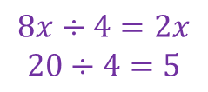
24
7
30
Date
Factorising
EQ – Describe the process of factorising an expression?
Factorising is the opposite of expanding (Put in brackets)
It is used to simplify expressions and solve problems
To factorise –
Find the HCF of all the terms
This goes outside the bracket
Divide each term by the HCF
Example – Factorise $8x+20$
$$The HCF of 8x and 20 is 4$$
$$4($$
$$8x÷4=2x$$
$$20÷4=5$$
7

Slide 24
24
7
30
Date
Factorising
EQ – Describe the process of factorising an expression?
Factorising is the opposite of expanding (Put in brackets)
It is used to simplify expressions and solve problems
To factorise –
Find the HCF of all the terms
This goes outside the bracket
Divide each term by the HCF
Put the result inside the bracket
Example – Factorise $8x+20$
$$The HCF of 8x and 20 is 4$$
$$4($$
$$8x÷4=2x$$
$$20÷4=5$$
7

Slide 25

24
7
30
Date
Factorising
EQ – Describe the process of factorising an expression?
Factorising is the opposite of expanding (Put in brackets)
It is used to simplify expressions and solve problems
To factorise –
Find the HCF of all the terms
This goes outside the bracket
Divide each term by the HCF
Put the result inside the bracket
Example – Factorise $8x+20$
$$The HCF of 8x and 20 is 4$$
$$4($$
$$8x÷4=2x$$
$$20÷4=5$$
$$4(2x+5)$$
7

Slide 26

24
7
30
Date
Factorising
EQ – Describe the process of factorising an expression?
Factorising is the opposite of expanding (Put in brackets)
It is used to simplify expressions and solve problems
To factorise –
Find the HCF of all the terms
This goes outside the bracket
Divide each term by the HCF
Put the result inside the bracket
Example – Factorise $8x+20$
$$The HCF of 8x and 20 is 4$$
$$4($$
$$8x÷4=2x$$
$$20÷4=5$$
$$4(2x+5)$$
$$Answers − 8x+20=4(2x+5)$$
7

Slide 27
Fill in the questions

Slide 28
24
7
30
Date
Factorising
EQ – Describe the process of factorising an expression?
Factorising is the opposite of expanding (Put in brackets)
It is used to simplify expressions and solve problems
What is factorising?
To factorise –
Find the HCF of all the terms
This goes outside the bracket
Divide each term by the HCF
Put the result inside the bracket
Example – Factorise $8x+20$
$$The HCF of 8x and 20 is 4$$
$$4($$
$$8x÷4=2x$$
$$20÷4=5$$
$$4(2x+5)$$
$$Answers − 8x+20=4(2x+5)$$
7

Slide 29
24
7
30
Date
Factorising
EQ – Describe the process of factorising an expression?
Factorising is the opposite of expanding (Put in brackets)
It is used to simplify expressions and solve problems
What is factorising?
How do I factorise an expression?
To factorise –
Find the HCF of all the terms
This goes outside the bracket
Divide each term by the HCF
Put the result inside the bracket
Example – Factorise $8x+20$
$$The HCF of 8x and 20 is 4$$
$$4($$
$$8x÷4=2x$$
$$20÷4=5$$
$$4(2x+5)$$
$$Answers − 8x+20=4(2x+5)$$
7

Slide 30
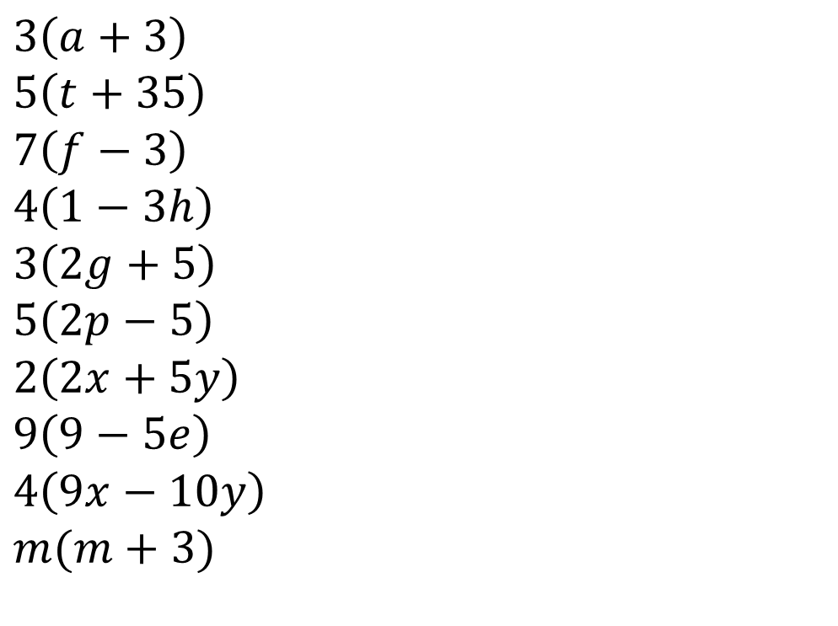
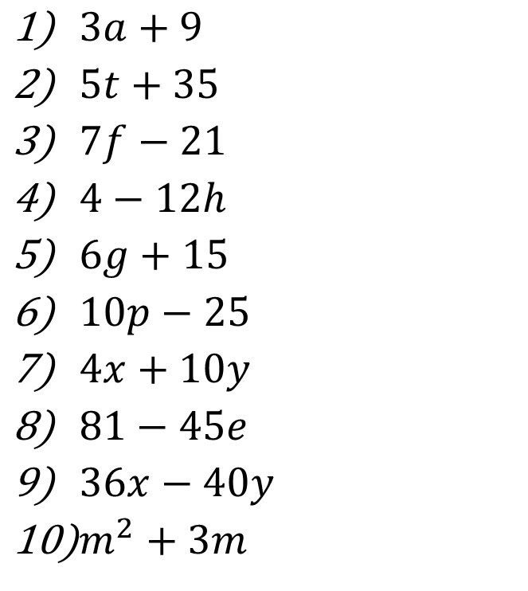
Task - Factorise
$3a+9$
$5t+35$
$7f−21$
$4−12h$
$6g+15$
$10p−25$
$4x+10y$
$81−45e$
$36x−40y$
$m^{2}+3m$
$$3\left(a+3\right)$$
$$5\left(t+35\right)$$
$$7\left(f−3\right)$$
$$4\left(1−3h\right)$$
$$3\left(2g+5\right)$$
$$5\left(2p−5\right)$$
$$2\left(2x+5y\right)$$
$$9\left(9−5e\right)$$
$$4\left(9x−10y\right)$$
$$m(m+3)$$

Slide 31
Notes Review
24, 7 ,30
Date
Title
Essential question
Notes complete
Notes complete with colour and diagrams
Questions completed
Contents page filed in
Formula page filled in

Slide 32
Homework
Review your notes and write a summary answering the essential question.

